Slide 1
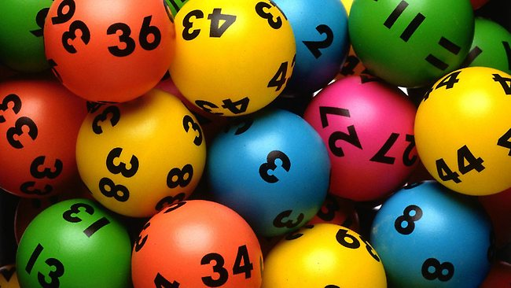
Lotto game

Slide 2
Word Lotto
선생님이 보여주는 단어 중에서 3개를 골라 영어 공책에 적으세요.
3개 모두 일치 : 3점 2개 일치 : 2점
1개 일치 : 1점

Slide 3
Word Lotto 1
star
yours
glove
watch
mine
find
heart
whose
circle

Slide 4
Word Lotto 2
cap
whose
yours
shoe
bottle
star
phone
umbrella
find

Slide 5
Word Lotto 3
watch
shoe
circle
umbrella
cap
phone
mine
heart
glove

Slide 6
Word Lotto 4
yours
find
star
bottle
whose
circle
mine
heart
glove

Slide 7
Word Lotto 5
whose
find
shoe
cap
bottle
phone
star
umbrella
watch

Slide 8
Word Lotto 6
glove
umbrella
heart
circle
watch
mine
phone
yours
shoe

Slide 9
Word Lotto 7
mine
yours
heart
find
bottle
star
circle
whose
cap

Slide 10
Word Lotto 8
phone
whose
find
watch
glove
shoe
cap
bottle
umbrella

Slide 11
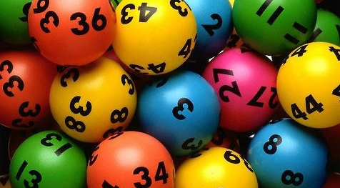
Count your score! 5~9점(간식1개), 10~14(간식2개), 15~(간식3개)

